Slide 1

Advanced Computer Vision
Naeemullah Khan
naeemullah.khan@kaust.edu.sa
KAUST Academy
King Abdullah University of Science and Technology
Computer Vision

Slide 2
Batch Normalization
Consider a single layer y = Wx
The following could lead to tough optimazation
Inputs x are not centered around zero (need large bias)
Inputs x have different scaling per element (entries in W will need to vary a lot)
⁰Slide based on CS231n by Fei-Fei Li, Yunzhu Li & Ruohan Gao
Computer Vision

Slide 3
Batch Normalization
Consider a single layer y = Wx
The following could lead to tough optimazation
Inputs x are not centered around zero (need large bias)
Inputs x have different scaling per element (entries in W will need to vary a lot)
Idea: Force inputs to be ”nicely scaled” at each layer!
⁰Slide based on CS231n by Fei-Fei Li, Yunzhu Li & Ruohan Gao
Computer Vision

Slide 4
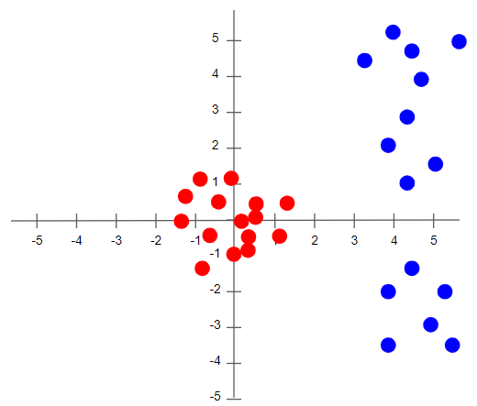
Normalization
https://towardsdatascience.com/batch-norm-explained-visually-how-it-works-and-why-neural-networks-need-it-b18919692739
Computer Vision

Slide 5
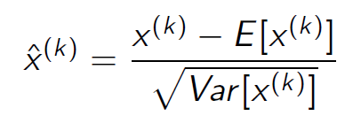
Batch Normalization
Consider a batch of activations at some layer. To make each dimension zero-mean unit-variance, apply:
⁰Slide based on CS231n by Fei-Fei Li, Yunzhu Li & Ruohan Gao
Computer Vision

Slide 6
Batch Normalization
Consider a batch of activations at some layer. To make each dimension zero-mean unit-variance, apply:
Problem: What if zero-mean, unit variance is too hard of a constraint?
⁰Slide based on CS231n by Fei-Fei Li, Yunzhu Li & Ruohan Gao
Computer Vision

Slide 7
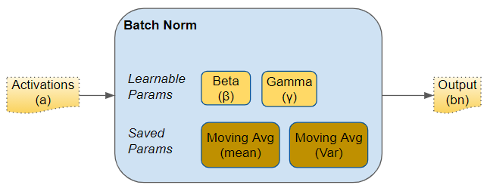
Batch Normalization
https://towardsdatascience.com/batch-norm-explained-visually-how-it-works-and-why-neural-networks-need-it-b18919692739
Computer Vision

Slide 8
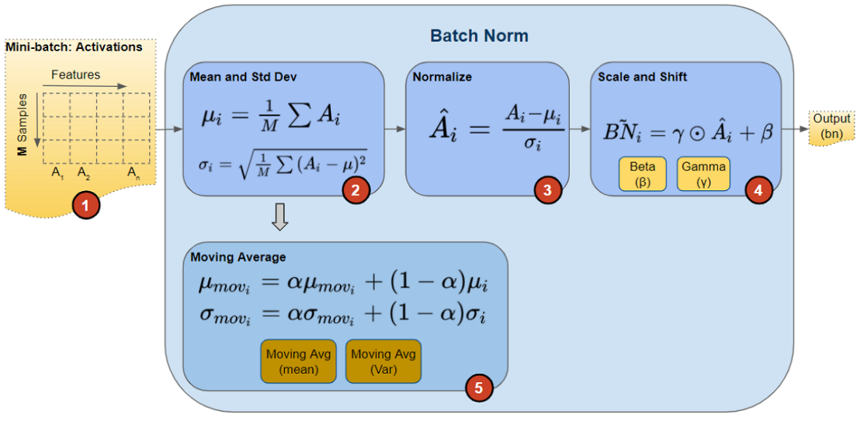
Batch Normalization
https://towardsdatascience.com/batch-norm-explained-visually-how-it-works-and-why-neural-networks-need-it-b18919692739
Computer Vision

Slide 9
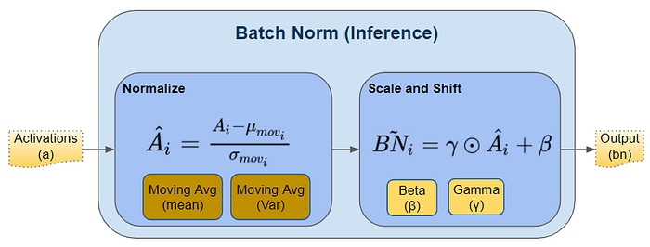
Batch Normalization
https://towardsdatascience.com/batch-norm-explained-visually-how-it-works-and-why-neural-networks-need-it-b18919692739
Computer Vision

Slide 10
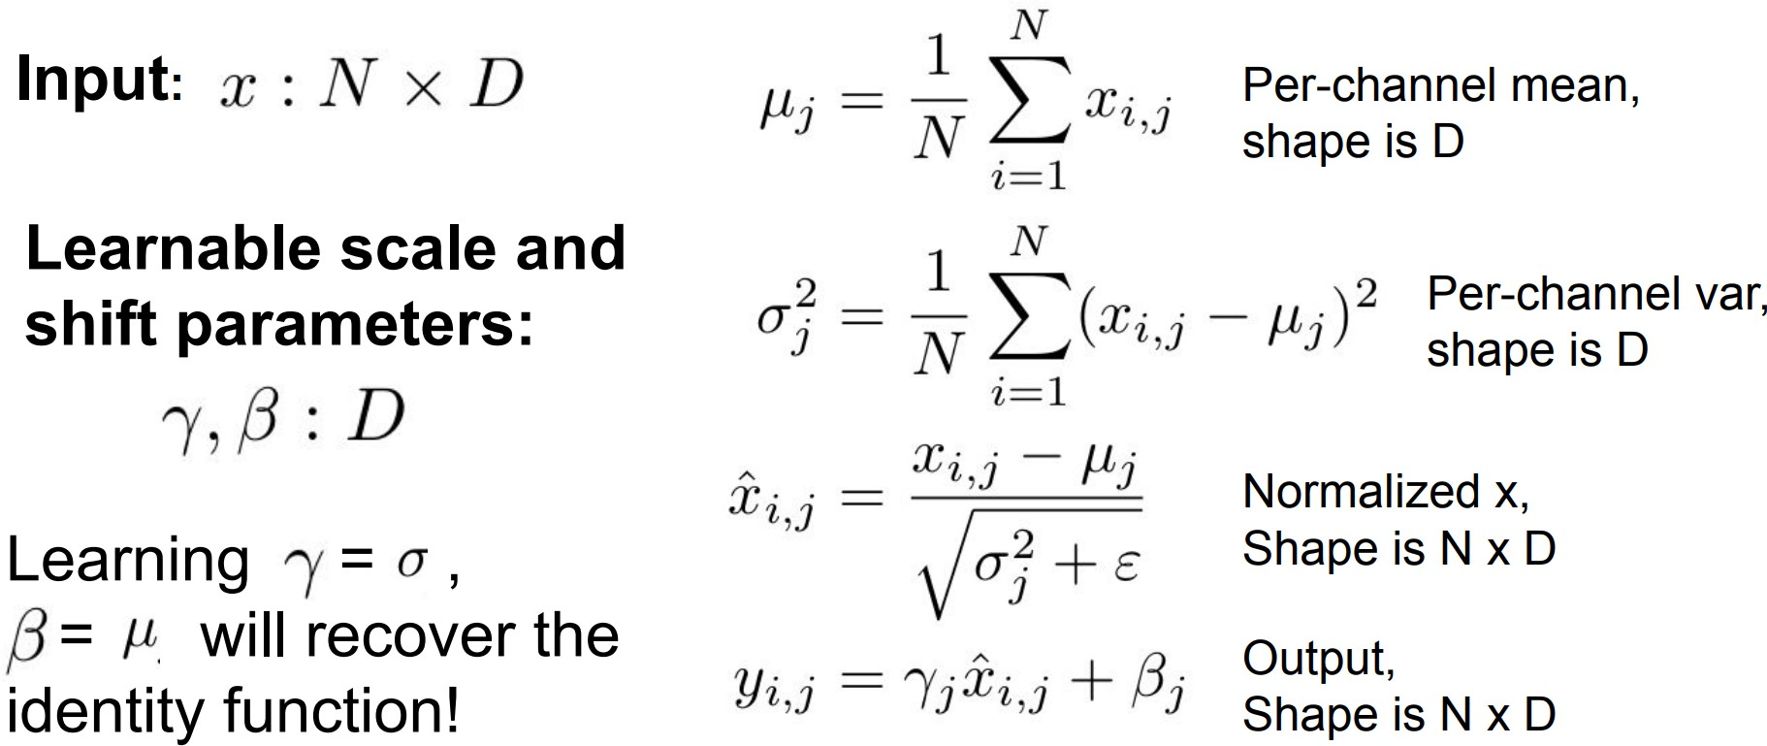
Batch Normalization
⁰Slide based on CS231n by Fei-Fei Li, Yunzhu Li & Ruohan Gao
Computer Vision

Slide 11
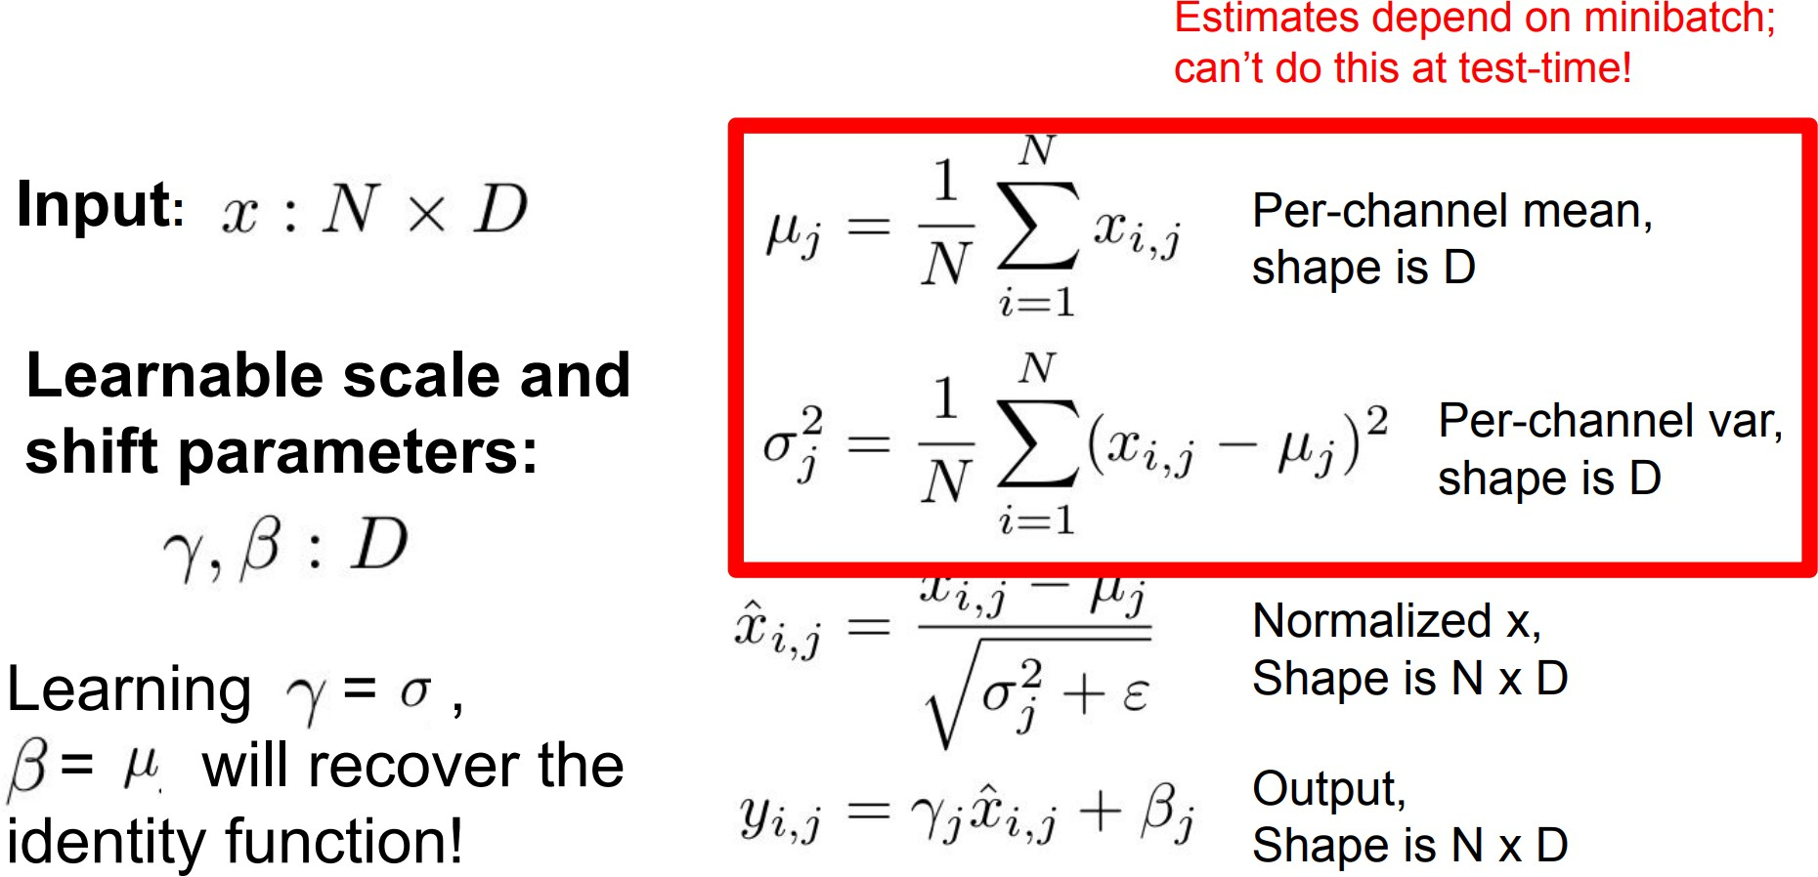
Batch Normalization
Computer Vision

Slide 12
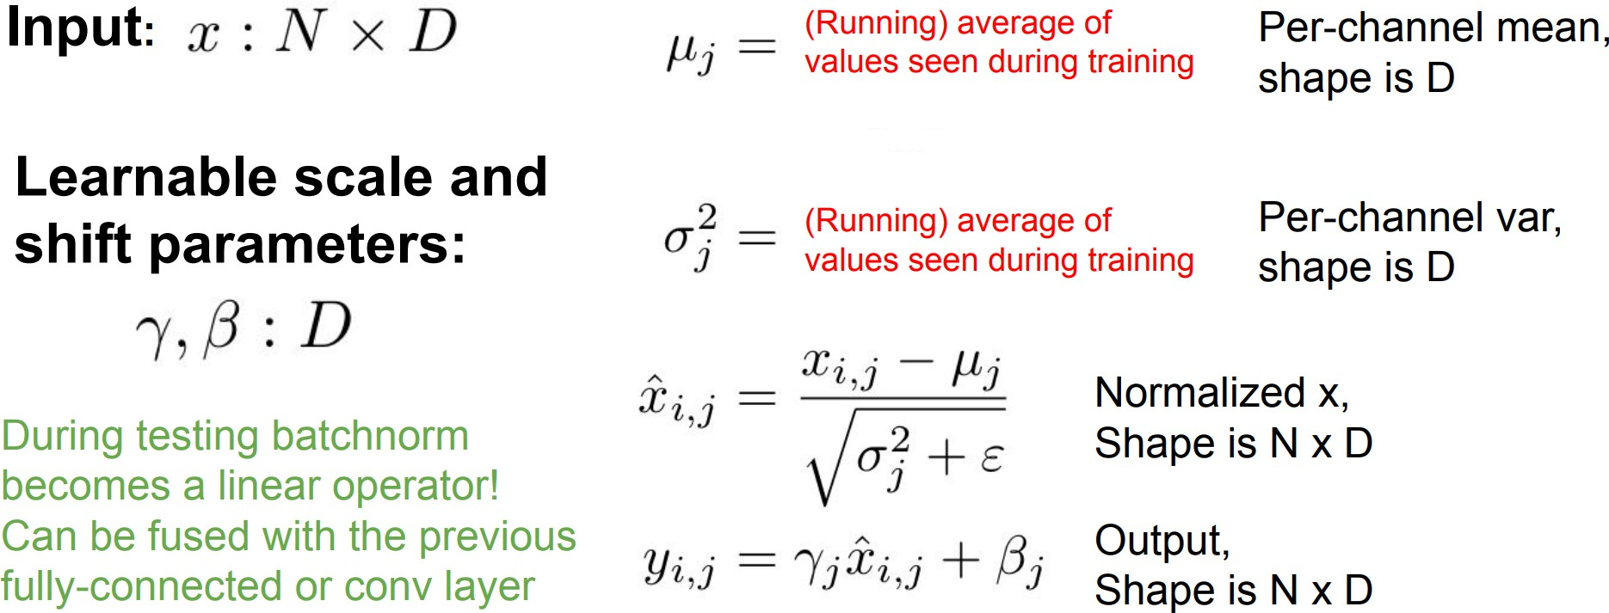
Batch Normalization
⁰Slide based on CS231n by Fei-Fei Li, Yunzhu Li & Ruohan Gao
Computer Vision

Slide 13
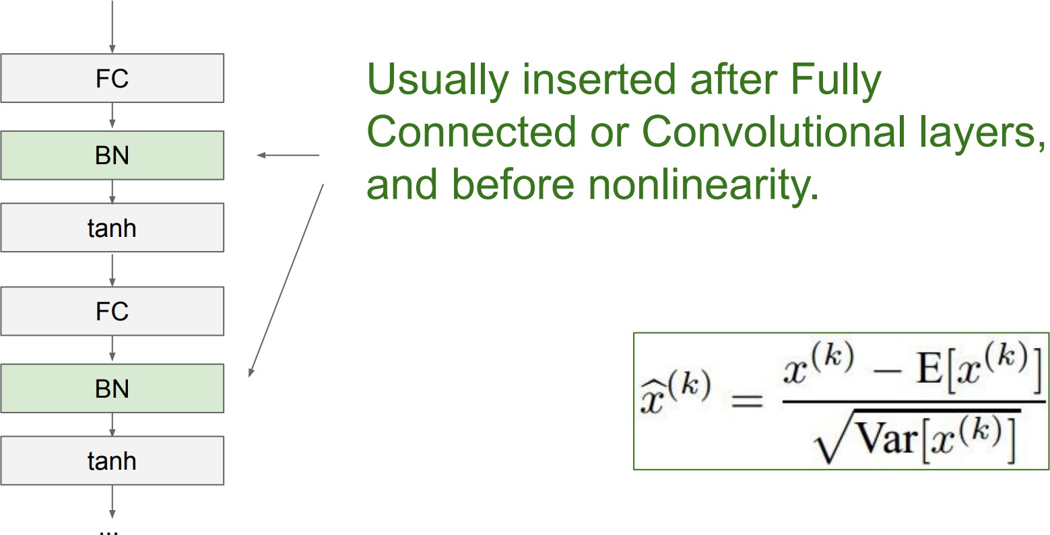
Batch Normalization
Computer Vision

Slide 14
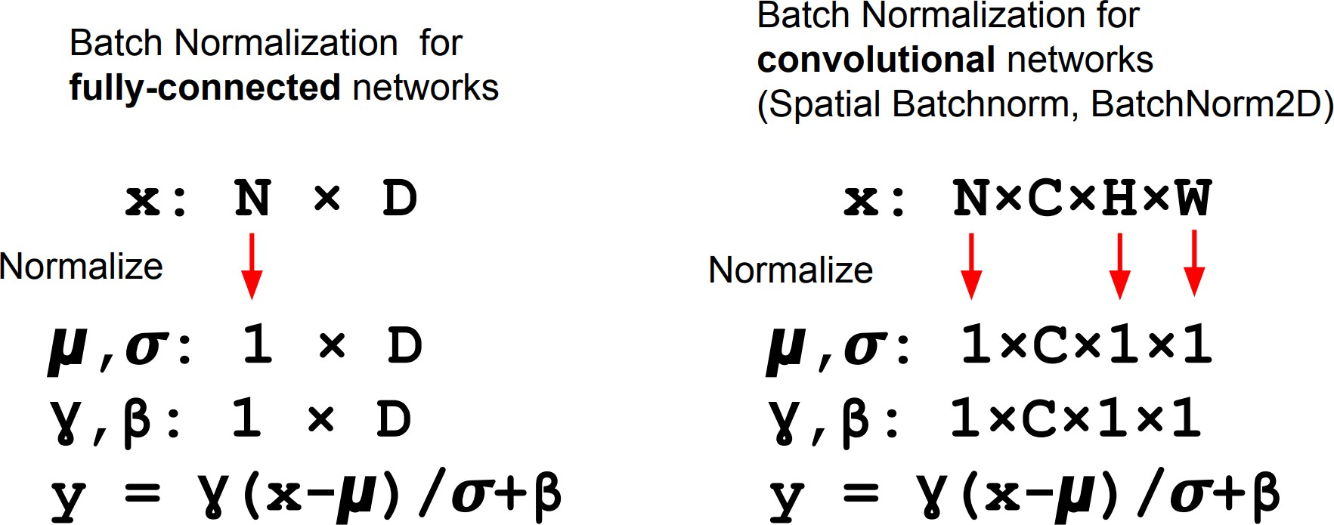
Batch Normalization
⁰Slide based on CS231n by Fei-Fei Li, Yunzhu Li & Ruohan Gao
Computer Vision

Slide 15
Batch Normalization
Advantages:
Makes deep networks much easier to train!
Improves gradient flow
Allows higher learning rates, faster convergence
Networks become more robust to initialization
Acts as regularization during training
Zero overhead at test-time: can be fused with conv!
⁰Slide based on CS231n by Fei-Fei Li, Yunzhu Li & Ruohan Gao
Computer Vision

Slide 16
Batch Normalization
Advantages:
Makes deep networks much easier to train!
Improves gradient flow
Allows higher learning rates, faster convergence
Networks become more robust to initialization
Acts as regularization during training
Zero overhead at test-time: can be fused with conv!
Disadvantages:
Behaves differently during training and testing: this is a very common source of bugs!
⁰Slide based on CS231n by Fei-Fei Li, Yunzhu Li & Ruohan Gao
Computer Vision

Slide 17
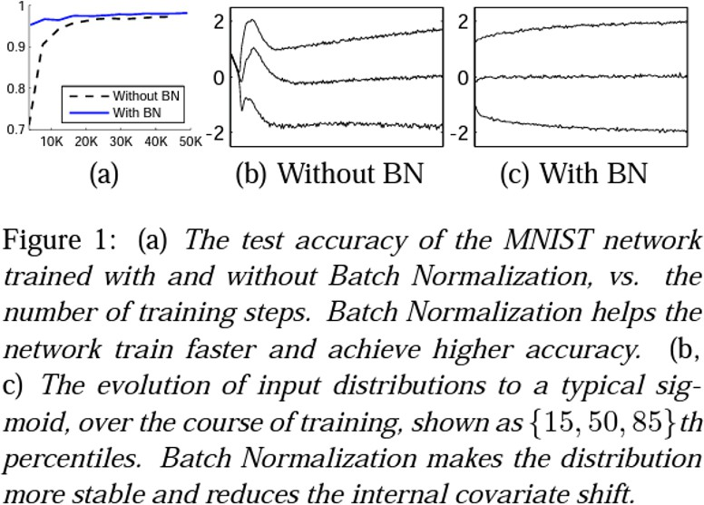
Batch Normalization
⁰Ioffe and Szegedy 2015
Computer Vision

